Slide 1
INTRODUCTION TO PROGRAMMING LANGUAGE

Slide 2
What is a language? Language is the medium of communication to share ideas, opinion with each other. For an example, if we want to communicate with someone, we need a language it may be English, Hindi, Spanish or another language. But you need at least one language to communicate with someone (human/person).
What is a programming language?
To communicate with a person, you need a language. Same if you need to communicate with the computer, you need a programming language. Without any programming language you cannot communicate with the computer.
Thus, programming language is the medium of communication between you (a person) and a computer system. It is the set of some instructions written in a specific style (coding) to instruct the computer to do some specific task.

Slide 3
Types of computer programming languages
There are basically three types of computer programming languages, they are 1.Low level programming languages 2.High level programming languages 3.Middle level programming languages
1) Low level programming languages Low-level languages are designed to operate and handle the entire hardware and instructions set architecture of a computer directly.
Low-level languages are considered to be closer to computers. In other words, their prime function is to operate, manage and manipulate the computing hardware and components. Programs and applications written in a low-level language are directly executable on the computing hardware without any interpretation or translation.
Low Level programming language programs are faster than High Level programming language programs as they have less keywords, symbols and no need (less need) to convert into Machine Code.
Machine language and assembly language are popular examples of low-level languages.

Slide 4
2) High level programming languages
These are the machine independent programming languages, which are easy to write, read, edit and understand.
A high-level language has a higher level of abstraction from the computer, and focuses more on the programming logic rather than the underlying hardware components such as memory addressing and register utilization.
A high-level language does not require addressing hardware constraints when developing a program. However, every single program written in a high-level language must be interpreted into machine language before being executed by the computer.
The languages like Java, .Net, Pascal, COBOL, C++, C, C# and other (which are very popular now to develop user end applications). These languages come under the high level programming language category.

Slide 5
3)Middle Level programming language Since, there is no such category of computer programming languages, but the programming languages that have features of low level and high level programming languages come under this category. Hence, we can say that the programming languages which have features of Low Level as well as High Level programming languages known as "Middle Level" programming language.
C programming languages is the best example of Middle Level Programming languages as it has features of low level and high level programming languages both.

Slide 6
Assembly Language
A symbolic representation of the machine language of a specific processor.
Is converted to machine code by an assembler.
Usually, each line of assembly code produces one machine instruction (One-to-one correspondence).
Programming in assembly language is slow and error-prone but is more efficient in terms of hardware performance.
Mnemonic representation of the instructions and data
Example:
Load Price
Add Tax
Store Cost

Slide 7
Compiler
A program that converts another program from some source language (or high-level programming language / HLL) to machine language (object code).
Some compilers output assembly language which is then converted to machine language by a separate assembler.
Compiler is distinguished from an assembler by the fact that each input statement, in general, correspond to more than one machine instruction.

Slide 8
Interpreter
An interpreter is a computer program that is used to directly execute program instructions written using one of the many high-level programming languages. The interpreter transforms the high-level program into an intermediate language that it then executes, or it could parse the high-level source code and then performs the commands directly, which is done line by line or statement by statement.
Linker
A program that pulls other programs together so that they can run.
Most programs are very large and consist of several modules.
Even small programs use existing code provided by the programming environment called libraries.
The linker pulls everything together, makes sure that references to other parts of the program (code) are resolved.

Slide 9
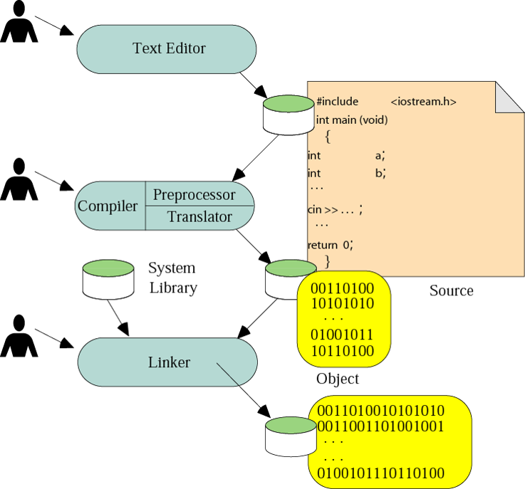
Building a program

Slide 10
Running Programs
Steps that the computer goes through to run a program:
Memory
Machine language program (executable file)
C P U
Input Data
Data entered during execution
Computed results
Program Output

Slide 11
Program Execution
Steps taken by the CPU to run a program (instructions are in machine language):
Fetch an instruction
Decode (interpret) the instruction
Retrieve data, if needed
Execute (perform) actual processing
Store the results, if needed

Slide 12
Program Error
Syntax Errors:
Errors in grammar of the language
Runtime error:
When there are no syntax errors, but the program can’t complete execution
Divide by zero
Invalid input data
Logical errors:
The program completes execution, but delivers incorrect results
Incorrect usage of parentheses

Slide 13
Compilation
Source
Program
Compiler
Target
Program
Input
Target Program
Output
Compiler translates source into target (a machine language program)
Compiler goes away at execution time
Compiler is itself a machine language program, presumably created by compiling some other high-level program
Machine language, when written in a format understood by the OS is object code

Slide 14
Interpretation
Source
Program
Interpreter
Output
Input
The interpreter stays around during execution
It reads and executes statements one at a time

Slide 15
THANK YOU

